Slide 1
Innovation AllAgile
Veijo Hytti, CEO, Keto Software
Project Challenge, London 26.9.2019

Slide 2
Agenda
Intro: Keto, me and some thoughts about innovation
Human approach to innovation
AllAgile Soft Launch
25 minutes
Discussion Points
5-10 minutes

Slide 3
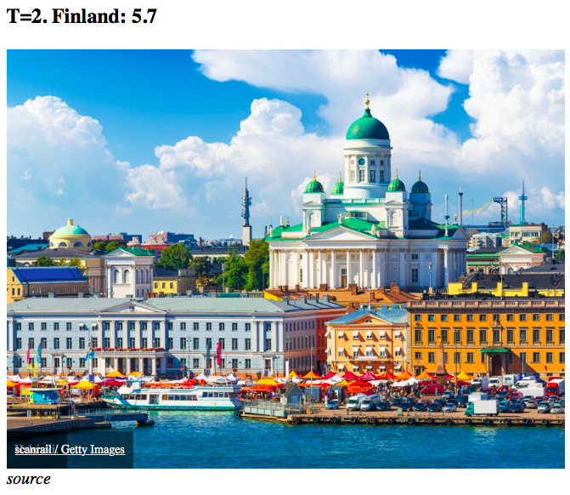
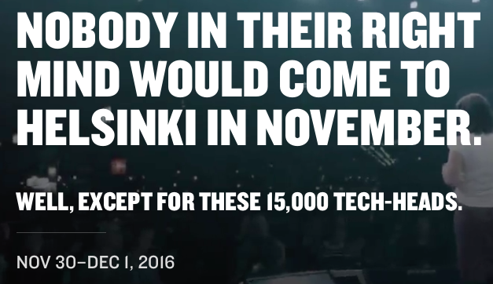
Made in Finland. One of the Most Innovative Countries.

Slide 4
Idea (Innovation) vs. Execution (PPM)
Innovation is more than just creating ideas. It’s the holistic process of turning them into projects, products, services and partnerships.
”Genius is 1% inspiration,
99% perspiration.”
- Thomas Alva Edison -
99%
1%
Idea
Innovation

Slide 5
Keto Supports a Roadmap from Idea to Innovation
Idea
Culture
Creativity
Openness
Execution
Transparency
Follow up and learning
Balance of resources
Holistic view
Innovation
Quality and costs
Operational efficiency
Competiveness
Growth engine

Slide 6
Our Clients Are Leading Innovators

Slide 7
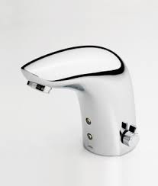
Simple UX

Slide 8
Low Code Platform for Innovation and Development
Idea funnel
Candidate/PPM
Project and resource management
Review
Analysis
Execute
Strategic objective
Program
Project
Temporary
projects
Project
Project
New feature request
Project
Launch
Customer
need
Agile PPM
Agile teams
Mandatory
legal
requirement
Review
Analysis
Candidate
Product increment
Continuous
Value flow
New technology
Experiment
Backlog
Sprint
Backlog
Sprint
Backlog
Sprint

Slide 9
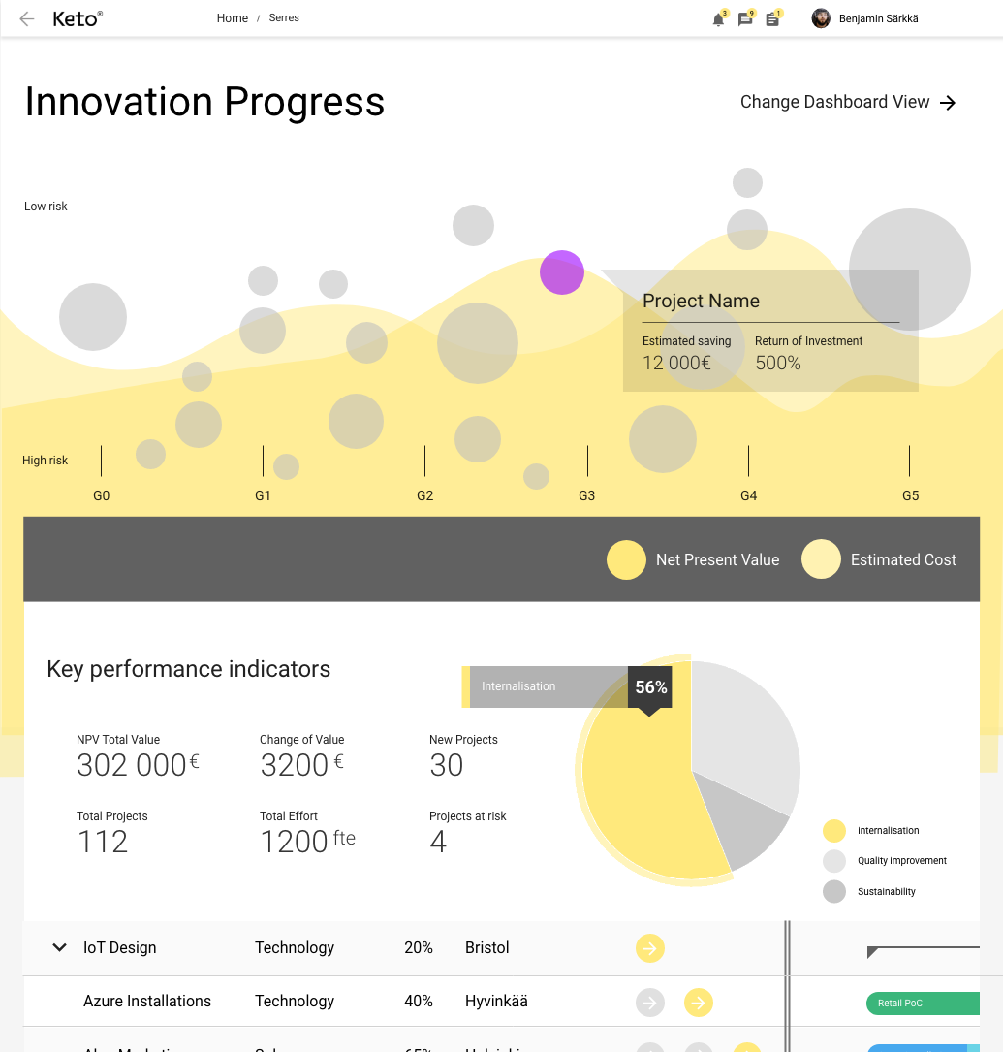
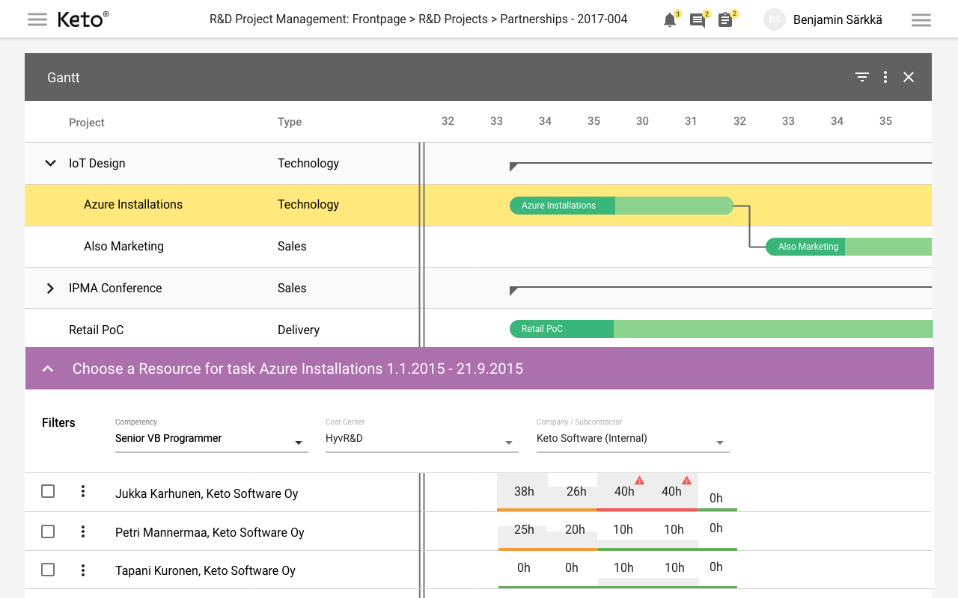
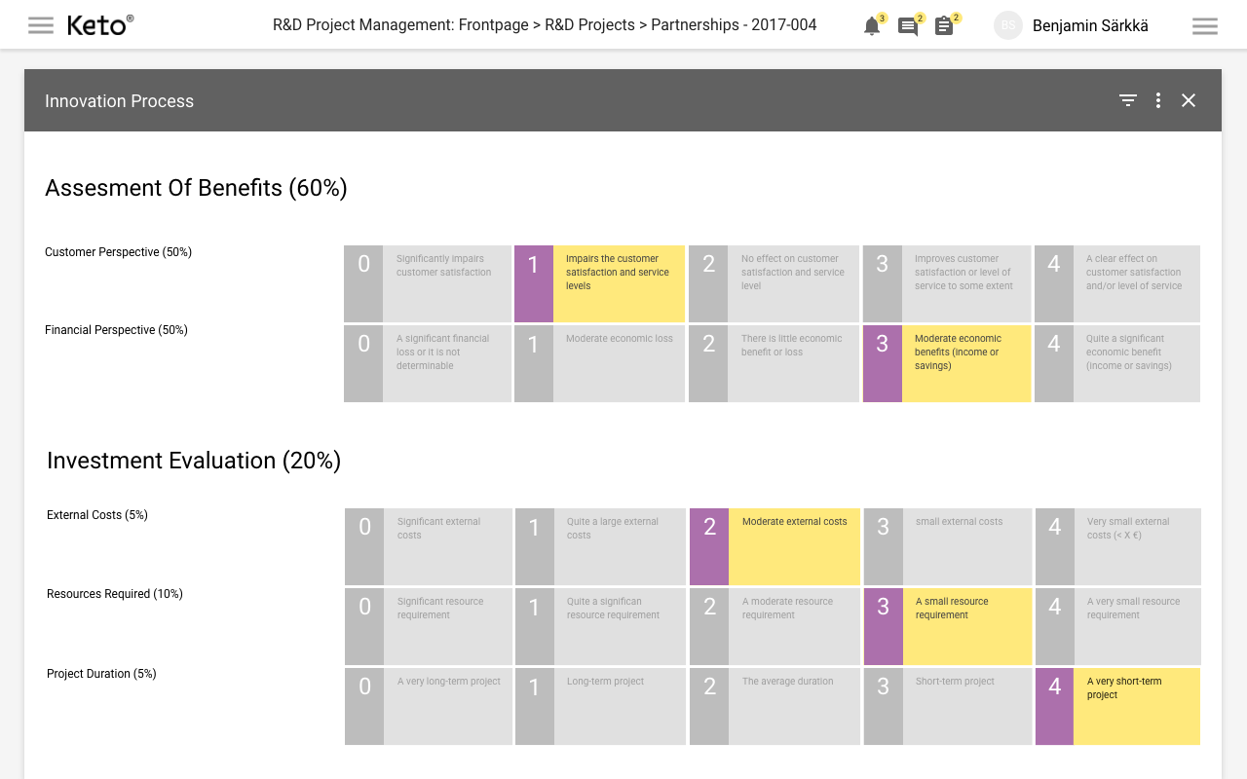

Slide 11
Nordic, Scandinavian and Finnish
Equality – women voting rights 110 years ago (FI 1906)
Democracy – everybody has the access to good design, education, health (Ikea, Finnish School System and NO oil)
Transparency – open data even in personal taxation
Nature – forests bring harmony, superfood and safety
Human – treating people like you want yourself to be treated
International – small countries have no other choice
Liberal – open-minded, freedoms, down-to-earth
Functional – everything works

Slide 12
Case Finland: Great Platform for Innovation
© 2019 Keto Software – Private & Confidential

Slide 13
Best place to raise children
© 2019 Keto Software – Private & Confidential

Slide 14
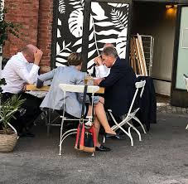
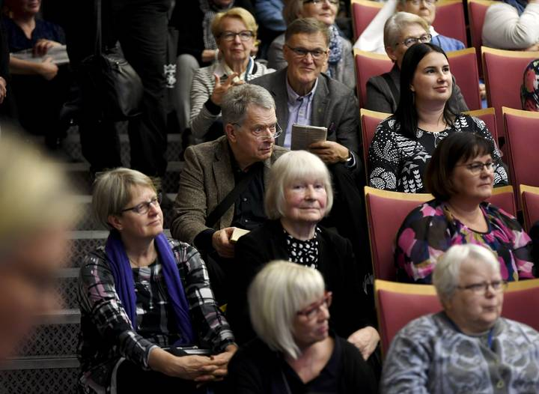
Mr President of Finland
Playing ”pipolätkä” in the park
Afterwork beer
Book fair
Holiday trip

Slide 15
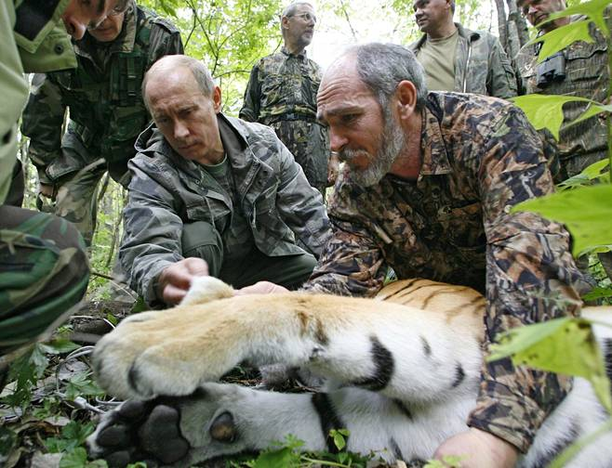
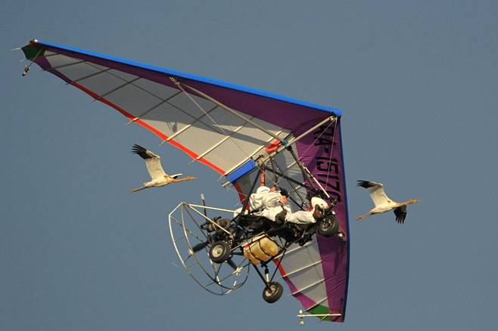
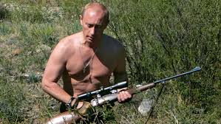
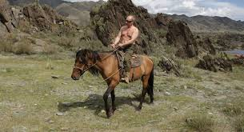
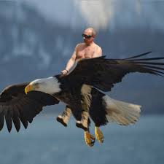
Mr President of East of Finland

Slide 16
Human beings in to robots
The Rational Approach

Slide 17
From robots back to human beings
The New Happy Corporate Employee Approach

Slide 18
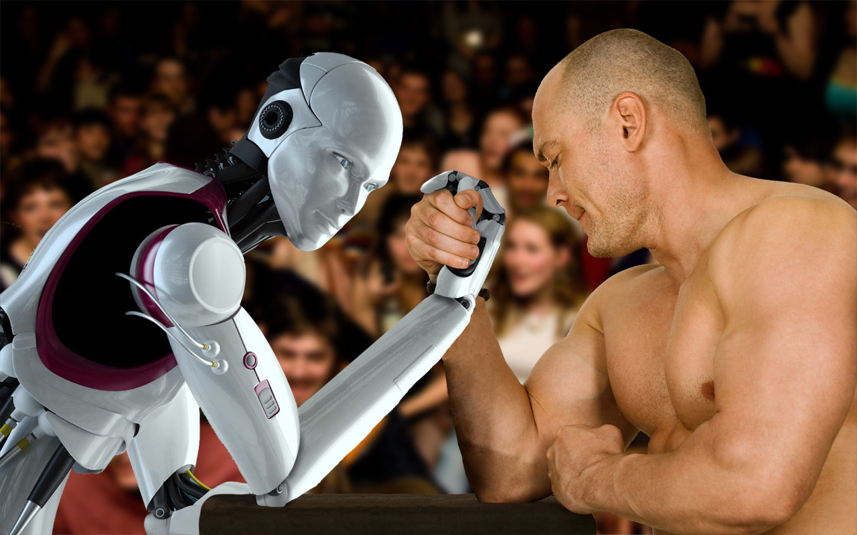
Third millennium skills

Slide 19
”Best people create the best games”
Ilkka Paananen, Co-Founder of Supercell

Slide 20
An example of a team in mobile games
Motion Graphic Designer
Storyteller
Game Designer
Concept Planner
Game Animator
Game Analytics Specialist
Digital Marketing Expert
Music and Effects Composer
________________________
IT Engineer
Software Developer

Slide 21
3 years & 3 billion. 7 lessons from Supercell
Practise
Attract the best people and give them a free-hand
Fail (celebrate) and start again
Timing (tablet first / Clash of Clans)
Discover what the users are willing to pay
Investors buy a team, not a product
Share the success
Aalto University – Developing Entrepreneurship

Slide 22
Future is COMMUNICATING and INVENTING TOGETHER
Assumption of STEM dominating the future - Do not overvalue STEM over humanities
SCIENCE (how to build)
HUMANITY (what and why to build)
Today’s world of intuitive technology needs humanity
1) specialised skills need less formalised education than in the past (techology like LEGOs)
2) skills that help us to work together as humans, with real work experience, judgement, historical concept
Equally important and hard

Slide 23
What do future employees learn in schools?
New national curriculum with transversal competences

Slide 24
Skills of the future worklife
Take Action
Lifelong Learning
Global Citizenship
Taking initiative
Responsibility
Collaboration skills
Learning skills
Empathy
Critical thinking
Digitalisation
Ability to adjust
Internationalisation

Slide 25
ALL AGILE AS A SERVICE

Slide 26
Slide not ready, hidden for now
KEY PARTNERS
Next Gen e-learning from Claned
LEAD Framework form Triari
Platform from Keto Software
KEY ACTIVITIES
Never customizing per customer
Providing great user experience by merging Claned, LEAD framework and Keto Platform to SaaS solution
On-line marketing, video and material production
Website development
Fully automated delivery
On-line billing
VALUE PROPOSITION
We will help industrialize digital change
Ability to lead change sustainably with 10% of traditional change cost
We help and guide customer on implementing lean portfolio model to drive change in organizations
We have individual learning paths that will use AI to estimate learning
Minimum viable product will offer guided implementation, adaptive learning platform, key metrics and visual & intuitive way of using on-line service
CUSTOMER RELATIONSHIPS
We get customers on-line and offer completely online solution that is easy to take into use
We offer collaboration, experience sharing platform for customers
Intended support model is minimal due to ease of use
CUSTOMERS
Typical customer is mid- to large customer with 5 M€+ digital development portfolio
Key role at customer is CDO who has little and big expectations
KEY RESOURCES
E-learning experts (freelancers)
Visual and Video production from Digital lighthouse
CHANNELS
Primarely digital marketing via LinkedIn and Google
Conference presence and public speaking
Pilot customers
COST STRUCTURE
Development cost of the solution will be largest part of the cost and front heavy for reaching MVP
Digital learning experts
Sales and marketing
Content experts
Digital, Video and content production
REVENUE STREAMS
On-line payments
Customers pay for sustainable way to drive digitalization and change into organizations
They currently pay for consulting and partially working SAFe transformations
Pricing will be segmented per organization size

Slide 27
CUSTOMER, CONTEXT AND CHALLENGES
CUSTOMER
Customers are service organizations, where digitalization has significant impact and devlopment portfolio value is 5M€+ annually.
Primary role doing buying is CDO, who has responsibility of digital business development. Usually CDO has lots of demands and limited resources.
CONTEXT
SPEED UP EVERYTHING: Sufficient speed won’t be enough
WORLD IS MORE COMPLEX: ecosystems, dependencies, regulations, all easy problems are already solved
DIFFICULTY IS RISING: Customers, especially in B2C markets are used at user friendly solutions.
CHALLENGES
Faster, more complex and demanding world requires way of working that fulfills:
Business driven (do the right things)
Agile and time to market
Looking at the big picture
Really leading with information
How to do this in sustainable way, is also a challenge.

Slide 28
SAFE – CURRENT SOLUTION
Challenges
Ideal Customer
Big product companies like Intel or Boeing, yet small compies try to implement it
Operating model
SAFe is too heavy to be operated in many environments
Choosing right parts from complex model is hard
Instructions rarely reach practical levels
It’s not business driven
Tools
Implementing and customizing tools is difficult and expensive process
Tools don’t instruct how to use the tool
Different practises for using tools
Making sense of the big picture is hard
Change
Not enough change leadership and rarely lacking
Cources, coaching and trainings are expensive
Not realistic view on what’s situation around organization and where to invest.
SAFe is solution that many use
Many organizations have tried to solve previously mentioned challenges with Scaled Agile Framework (market leader) developed at Nokia around very large product organization.
Organizations do grand SAFe transformation typically with lots of consultants, coaches and trainings.
Typical SAFe transformation for 200 – 1000 employee development organization is 500k – 1M€.
Many SAFe transformations are disappointments from business point of view.

Slide 29
ALL AGILE AS A SERVICE IS MOVING FROM MANUAL TRANSFORAMATION TO DIGITAL AND INDUSTRIAL WAY OF LEADING CHANGE
LEADING CHANGE WILL COSTS 10% OF TRADITIONAL WAY OF DOING THINGS
TIME TO SUSTAINABLY IMPLEMENT CHANGE WILL DRAMATICALLY DECREASE.

Slide 30
CUSTOMER JOURNEY
Through guided path in digitalization journey customer will have success and data to act accordingly
Tool instructs, teaches and helps people working with complex topics making work relevant and bite-sized
Over the time people get more skilled in new ways of working
Customer goes on-line and starts implementation of All Agile as a Service
Tool facilitates processes in multiple levels of organization based on best practices i.e. how to run development portfolio
All Agile will ask series of questions to set business goals and to establish the data with the user
All Agile will suggest topics for you that you might need more practice on and insights on what things are going well

Slide 31
LEAD CHANGE
LEAD BUSINESS
GROW COMPETENCES
360 DASHBOARD OF IDEA TO BENEFITS
BUSINESS OUTCOME BASED DEVELOPMENT
INDIVIDUAL LEARNING PATHS
AI SUPPORTED CHANGE
ALL AGILE
KETO PLATFORM
LEAD FRAMEWORK
CLANED DIGITAL LEARNING

Slide 32
ALL AGILE AS A SERVICE
All agile as a service will offer cloud based solution for CDO key challenges. Way of working, that will help organization to go cope in fast, complex and high usability demanding world. Solution combines simple way of working, supporting and guiding tool, digital learning and partially automated leading change.
WAY OF WORKING
LEAD Framework is simple and functional operating model that is designed to drive service organizations challenges in their digitalization journeys.
It combines agile way of working and managing the big picture.
Leading with information is central part of way of working.
TOOL
Tool will have built in LEAD Framework operating model and it will have strong guidance to act accordingly.
Ease of use will be key success factor for leading digital change.
Tool implementation is not big project, but it can be taken into use in 30 minutes by instructive questions.
LEARNING
Operating model will be taught with in-tool and packaged digital learning material.
Videos will offer easy and efficient way of learning new way of working.
Repetition and induction of new experts will be easy.
Solution utilizes digital learning possiblities to full extent.
CHANGE
Tool will have built-in best practices for leading change. Tool will collect how effective leading change is and offer insights.
These insights can be used to recommend automatic functions like repeat concepting learning module or manual activities like crystallize business goals to program managers.

Slide 33
DRAFT SCHEDULE
OCTOBER | NOVEMBER | DECEMBER | JANUARY | FEBRUARY | MARCH
START
FINETUNE
LAUNCH + MARKKINOINTI
FINALIZE PLANNING
MVP IMPLEMENTATION
PRODUCTIZATION
FUNDING
ACQUIRING PILOT CUSTOMERS
PILOT 1
PILOT 2
WEBSITES
VALUE PROMISE FOR CUSTOMER
ORDER AND ON-BOARDING AUTOMATION

Slide 34
CLICK HERE TO SIGN UP TO BETA

