Slide 1
Using information psychology
to better engage stakeholders

Slide 3
Stand 99

Slide 4
Free eBook
sbrown@polarisoft.com
Free eBook

Slide 5
Instinct &
common sense

Slide 6
Will you use a status report
in the next 30 days?

Slide 7
10M
Project
Professionals

Slide 8
For what purpose?

Slide 9
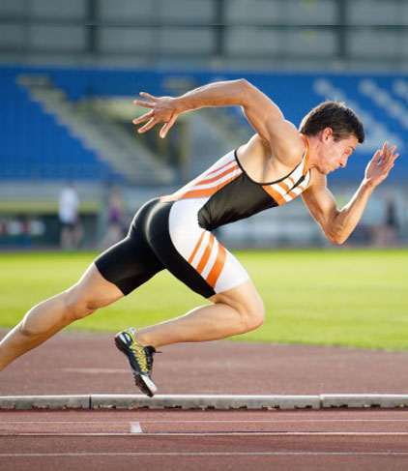
Take action

Slide 10
Invest
Do Work
Stop Work
Build Something
Manage Work
Write a Report
Improve Operations
Follow Safety
Governance
Resolve Issues
Risk Log
Further the Industry
Analyse Competitors
Read a Report
Status Reports
Purchase Materials
Write Documents
Timesheets

Slide 11
Principle #1
Reporting is useless,
unless it leads to action.

Slide 12
Email, Twitter, Facebook, Social media in the last 60 min?

Slide 13
Hate Reporting
Love Data

Slide 14
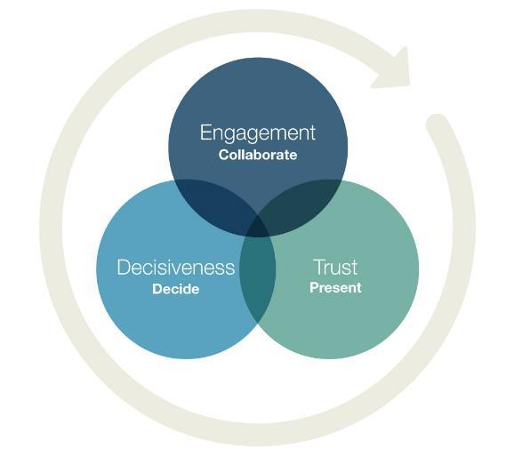
The Reporting Triad

Slide 15
Human
Behaviour
Your
Data
Trust
Improve
Fear
Monitor
Time
Analysis
Noise
Predict

Slide 16
Human
Behaviour
Your
Data
Decide
Take action

Slide 17
Engagement

Slide 18
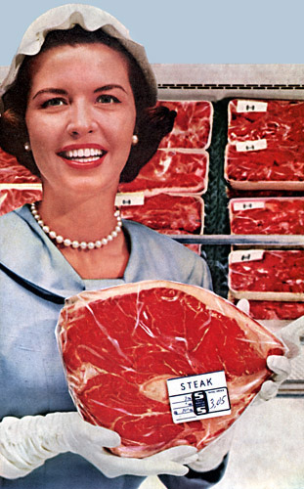
Who are they?
Do they know they are?
Are they all the same?

Slide 19
Team
Management
Big Boss

Slide 20
Principle #2
Design engagement
for your audience.

Slide 21
We receive
5x
As much information as we did in 1986
Outside we work we consume 100,500 words per day

Slide 22
Don’t start with...process, data or reporting
Start with the human

Slide 24
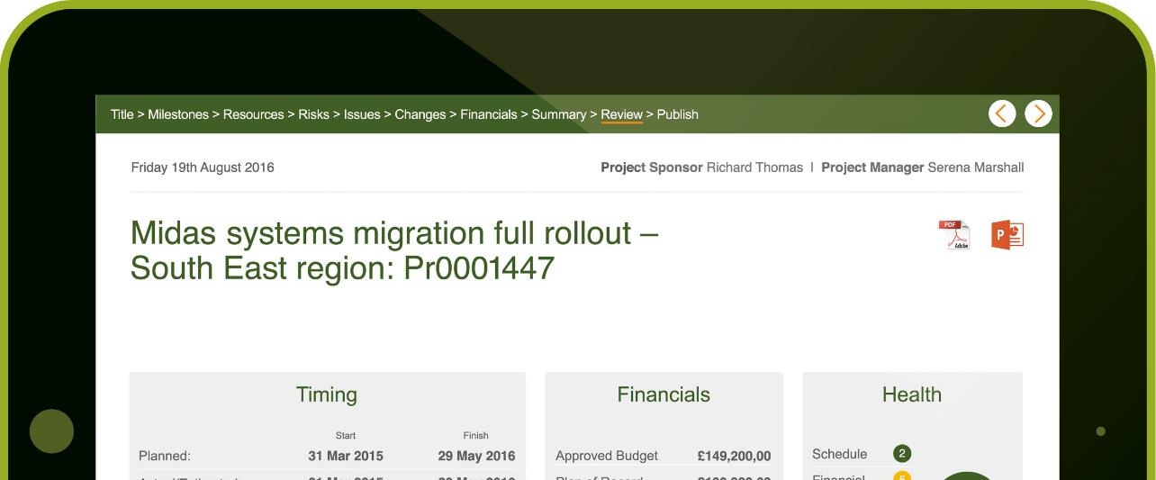
The 10 Minute Rule

Slide 25
Principle #3
Simple.

Slide 26
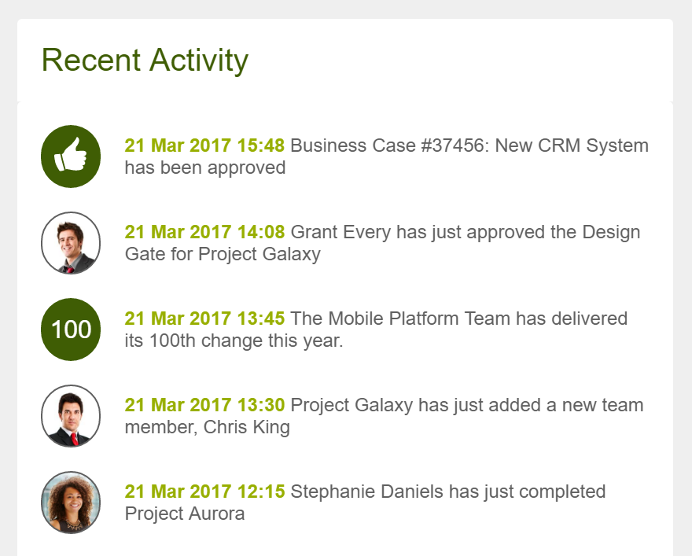
Positive feedback loop
84% participate to support a person or cause

Slide 27
Principle #4
Maintain engagement with a
positive feedback loop.

Slide 28
Trust

Slide 30
Worth a thousand words?

Slide 31
People following directions with illustrations do
Comprehension on labels:
323%
Better
70%
95%
than people following text alone.
without
illustrations
with
illustrations

Slide 32
Picture superiority effect
80% of what you see and do
10%
What you hear
20%
of what you read

Slide 33
How long does it take to get the sense of something visual?

Slide 34
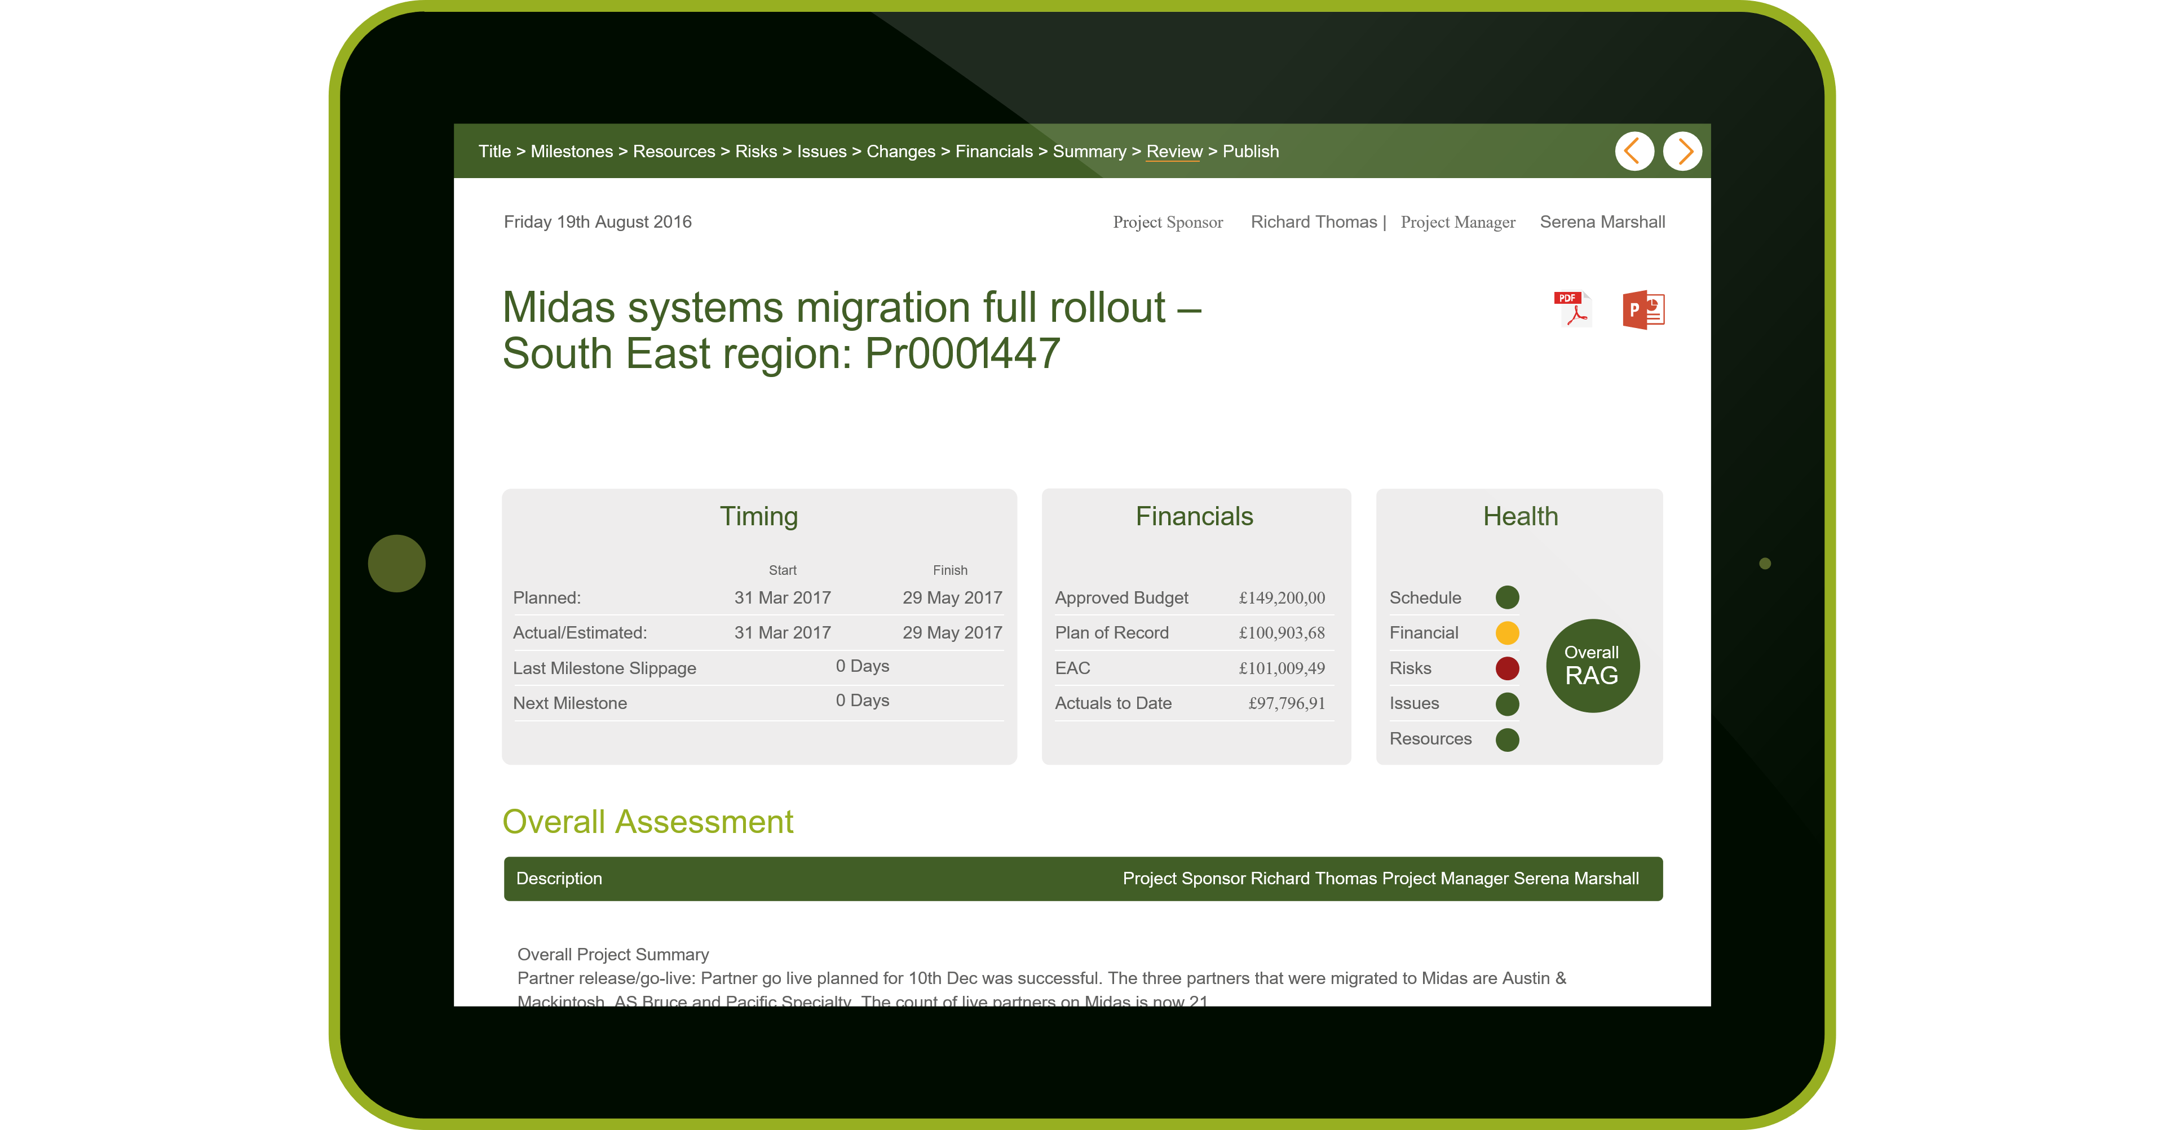

Slide 36
in
0:01
Seconds
We get a sense of a visualisation
50% of your brain
is involved in visual processing
70% of your sensory receptors are in your eyes

Slide 37
Are all
visual representations
the same?

Slide 38
Notes:
https://www.smithsonianmag.com/science-nature/how-does-the-brain-process-art-80541420/
https://www.scientificamerican.com/article/the-neuroscience-of-beauty/

Slide 39
Humans are Biased
Colour
Symmetry
Centred
Font
Layout
#s title

Slide 40
Jagged Edge Theory
Beauty
creates
initial
trust

Slide 41
Principle #5
If it is not attractive,
your story will not be told.

Slide 42
In practice?

Slide 43
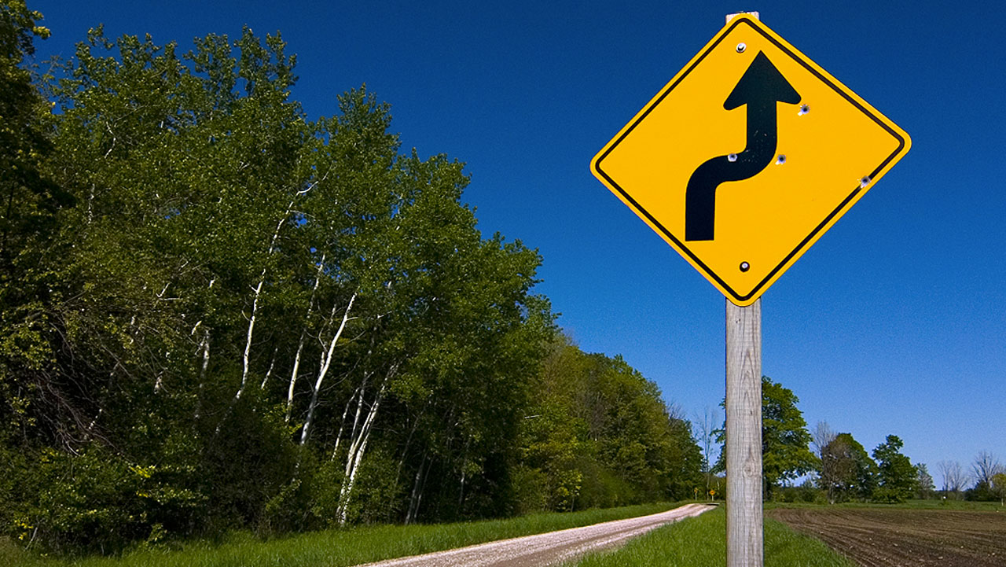
Agreed
Visual
Framework

Slide 44
Principle #6
Communicate using a
Visual Framework.

Slide 45
Decisiveness

Slide 46
Does that have the data from…?
What I would really need to see is…
Let’s have another meeting to take a look.

Slide 47
Prepared in advanced
Didn’t know the questions
Right visual for the job

Slide 49
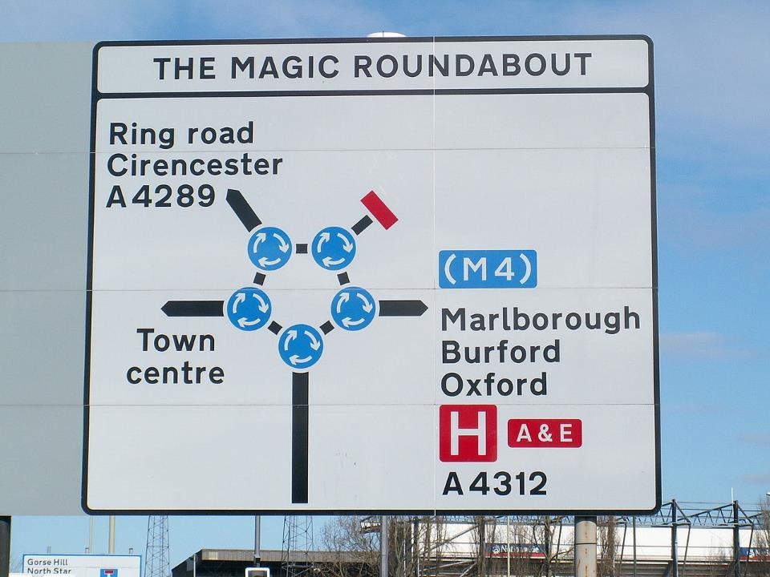

Slide 50
What was missing?

Slide 51
Agreed
Action
Framework

Slide 52
Principle #7
Visual-action framework
is about action.

Slide 53
Possible Decision
Practised Outcome
Possible Decision
Practised Outcome

Slide 54
Principle #8
Practice outcomes.

Slide 55
Does more data help?

Slide 56
Numbers related gut-decisions are
90%
accurate
Future
prediction
uncertainty

Slide 57
Principle #9
It’s ok to say:
That’s all we have – let’s make a decision.

Slide 58
Summary

Slide 59
Implement
the 10-minute
rule
Agree
Visual-Action
Frameworks
Remember
Clean/Beautiful
Counts

Slide 60
Final thought
Paradigm shift:
Data science can no longer be
just about data

Slide 61
Thank You Stephen Brown sbrown@polarisoft.com Polarisoft Stand 99

Slide 62
Questions

