Slide 1
It’s not all about the tool!
Programme Control
Having both worked on large Business Change Programmes over the last 25 years, we will talk about how there is a need for flexibility in terms of Programme Governance, depending on the scope of the Programme, the type of organisation, and the nature of your Sponsors and Stakeholders..
It is never a ‘one size fits all’, but there is always a minimum level of Programme Governance required. Successful Programmes will always have a great Team, People, and Communications, and appropriate governance. . A minimum level of governance, and ‘less is more’ approach to ongoing Programme Control has to be the start point for the majority!

Slide 2
What do we mean by…
…‘Tools’ in relation to Programme Control?
Reliance on an Enterprise PPM Software Solution to deliver successful Change Programmes
What do we mean by Enterprise PPM Software Solution?
Approximately £100k Plus investment
Manages all projects in an Organisation end to end
Integrates with all other Business Systems (HR, Finance etc)

Slide 4
Common mistakes by the majority
Try to develop into a Project Maturity that is a step too far (and possibly not required)
Engage with the whole business to develop requirements
This leads to only an e-ppm solution meeting the requirements resulting in:
Investing heavily (cost and time) and not realising the benefit, using minimum functionality, and only being used by resources with advanced level Project Management skills
Long lead times to implement across the whole organisation that the requirement has changed by the time implementation has completed
The journey of gathering requirements, selecting a solution, developing the business case fails at one of the stages – back to manual processes
Develop ‘in house’ because they’ve already got the license!
A solution that will not realistically fit the different Business Change Programmes in the organisation
Disclaimer - Understand some Project driven industries require e-ppm solutions, but the majority don’t!

Slide 5
Why am I here?
Opportunity to pass on my views and experience of delivering major programmes over many years to my clients
Frustration of working with my peers and the emphasis and time they invest on using complex tools to manage and communicate programmes of activity
Share my approach and priorities when I start any new assignment
Explain why the tool we decide to use is not, and should not be a major factor in delivering a successful outcome

Slide 6
What are my priorities at the start of a new programme?
Identify and appoint the Project Managers based on their:
Ability and knowledge
Sector experience
Fit with the culture and values of the client organisation
Fit with the nature and style of their stakeholders
Establish a relationship with my stakeholders and sponsor
Understand their style and approach
Recognise their priorities
Establish a “contract” for delivery and deliverables

Slide 7
What are my priorities at the start of a new programme?
Develop a communication strategy based on:
The organisation’s style and values
The sponsors requirements
Agreeing the minimum level of communication to satisfy the above
Establish a fit for purpose governance model based on
The organisation style and values
The sponsors requirements
A realistic view of how much time is available and required to maintain control

Slide 8
What are my priorities at the start of a new programme?
Identify the tool or tools we will use to manage the programme
Support the Governance model, not drive it
Simplify the Programme control process
Improve quality of Project meetings (discuss exceptions not status)
Demonstrate a Professional approach with Sponsors/Stakeholders

Slide 9
Identify, populate and brief programme management tool
5%
Identify PM’s
20%
20%
20%
35%

Slide 10
My experience
I have to get the programme established as quickly as possible, therefore:
I do not spend any time deciding which tool I should use to manage the programme
I do not spend any time training or briefing my project managers on how to report at programme level
My project managers are tasked with managing their individual projects with the necessary and appropriate rigour and attention to detail, using whatever tools they deem necessary or are comfortable using (Excel, MSP etc)
I am tasked with providing a simple and consistent summary of the programme status for the sponsors

Slide 11
My experience
One report has always been sufficient to achieve this goal, covering:
Achievements and targets for next period
High level milestones
RAG status of each workstream / project
Red risks and issues
Decisions required
I have never encountered a sponsor who has had to request more detail

Slide 12
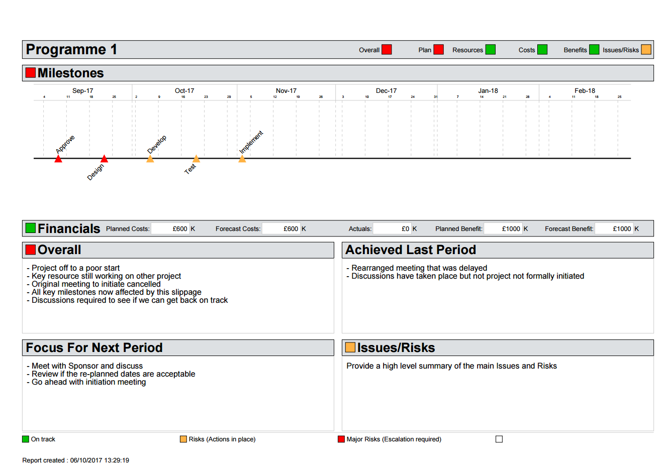
Programme / Project – 1 Page Summary Report

Slide 13
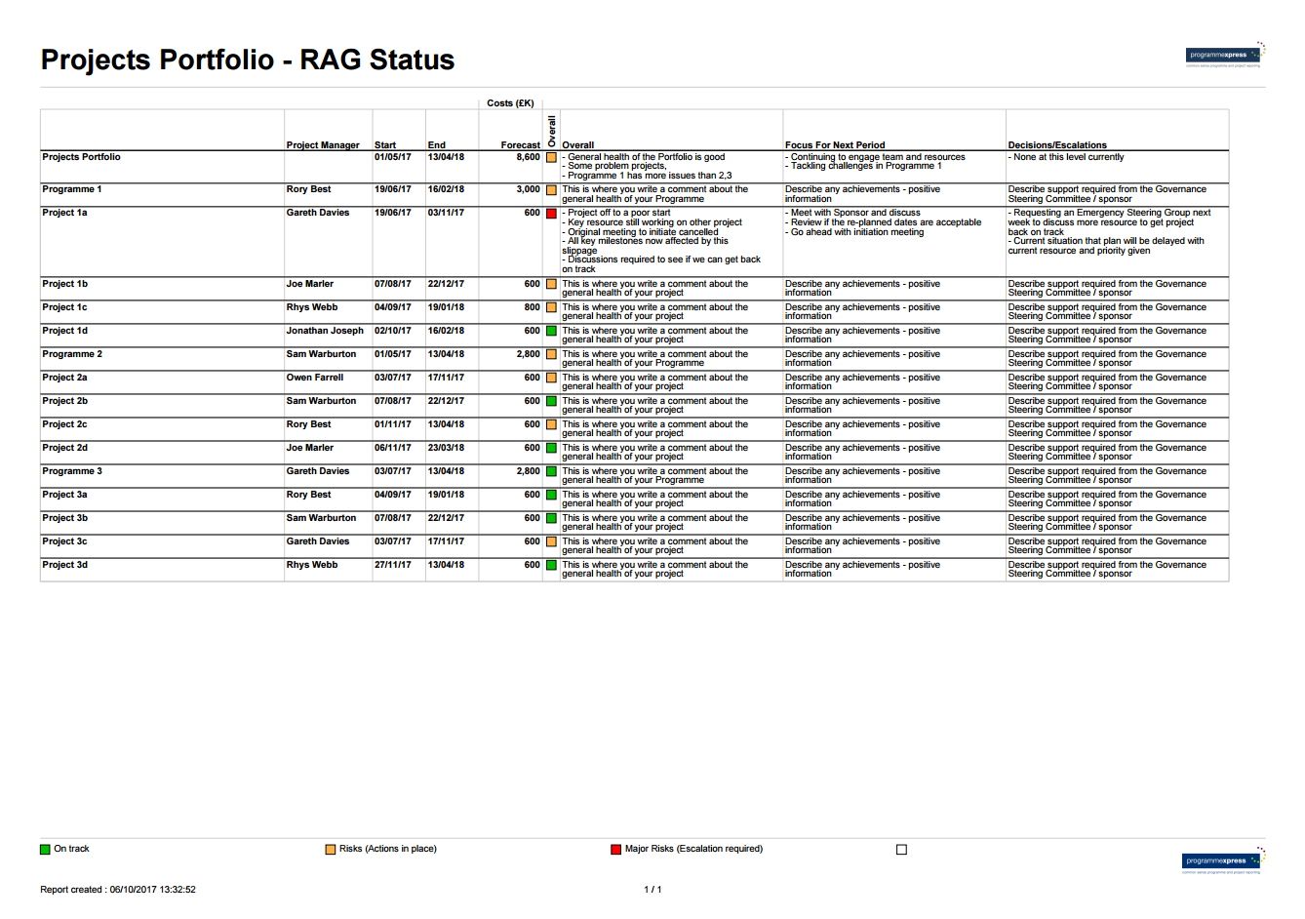
Programme - RAG Status Report

Slide 14
What are we saying so far?
In the real World:
Majority of successful Business Change Programmes rely on great people, communications and governance
Implementation of, or enforcement of a ‘rich in functionality’ tool will not work in most instances
Engaging the best team to deliver means they need flexibility to ‘do it their way’, at work stream/project level
There is ALWAYS a requirement for quality / timely Project Reporting, keep it simple and that’s a generic requirement!

Slide 15
What are we saying so far?
In the real World:
And if you automate that element, then:-
Real time reporting
Reduction of manual effort
Better quality meetings – discuss the exceptions, not the status

Slide 16
ProgrammExpress – Portfolio, Programme and Project Reporting
Went live 2002 – lessons learnt from the Year 2000 Programme
To meet specific requirements:-
Achieve consistency, consolidation and aggregation across Business Change Programmes
Automation and real time reporting, reducing time spent by Project Managers and Administrators
Supporting the minimum level of Programme Governance, specifically in terms of reporting periodic status
Simple enough for all organisational departments to utilise (not just IT and the skilled Project Managers)

Slide 17
KISS – The Key to Engagement
Simple
Complex
Engaged
Switched OFF
Project Manager
(Skilled)
CEO
Project Manager
(Business/Subject Matter Expert)
Programme Manager
PMO Director
CIO
Sponsor
Project Director
PMO Manager
Sponsor
IT Director
Business Change Director
Programme Director
Stakeholder

Slide 18
KISS – The Key to Engagement
Simple
Complex
Engaged
Switched OFF
Project Manager
(Skilled)
CEO
Project Manager
(Business/Subject Matter Expert)
Programme Manager
PMO Director
CIO
Sponsor
Project Director
PMO Manager
Sponsor
IT Director
Business Change Director
Programme Director
Stakeholder

Slide 19
KISS – The Key to Engagement
Simple
Complex
Engaged
Switched OFF
Project Manager
(Skilled)
CEO
Project Manager
(Business/Subject Matter Expert)
Programme Manager
PMO Director
CIO
Sponsor
Project Director
PMO Manager
Sponsor
IT Director
Business Change Director
Programme Director
Stakeholder

Slide 20
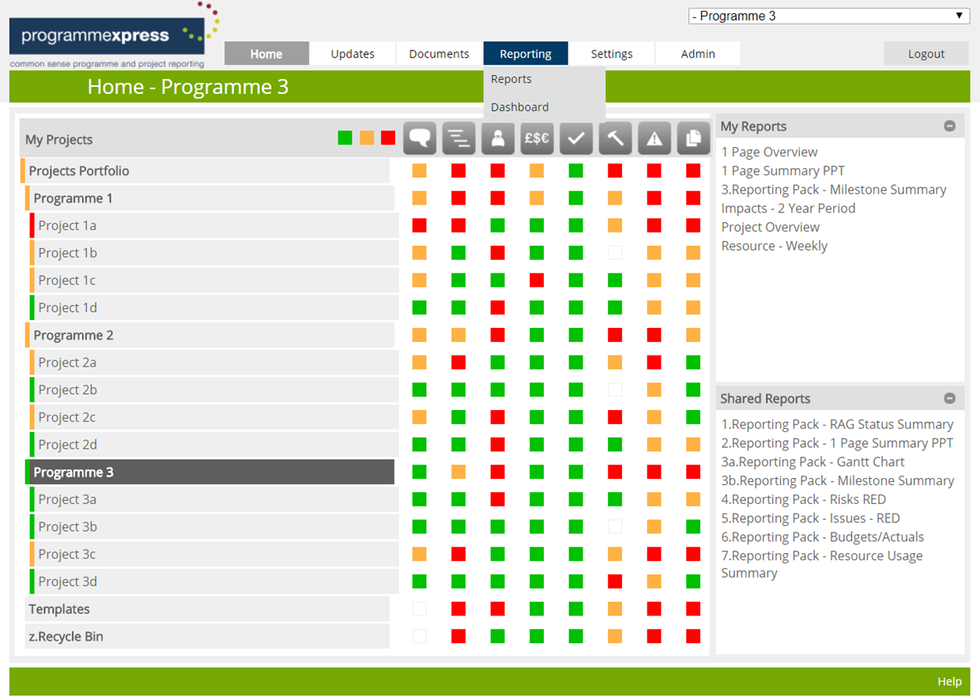
Home Screen – Total View

Slide 21
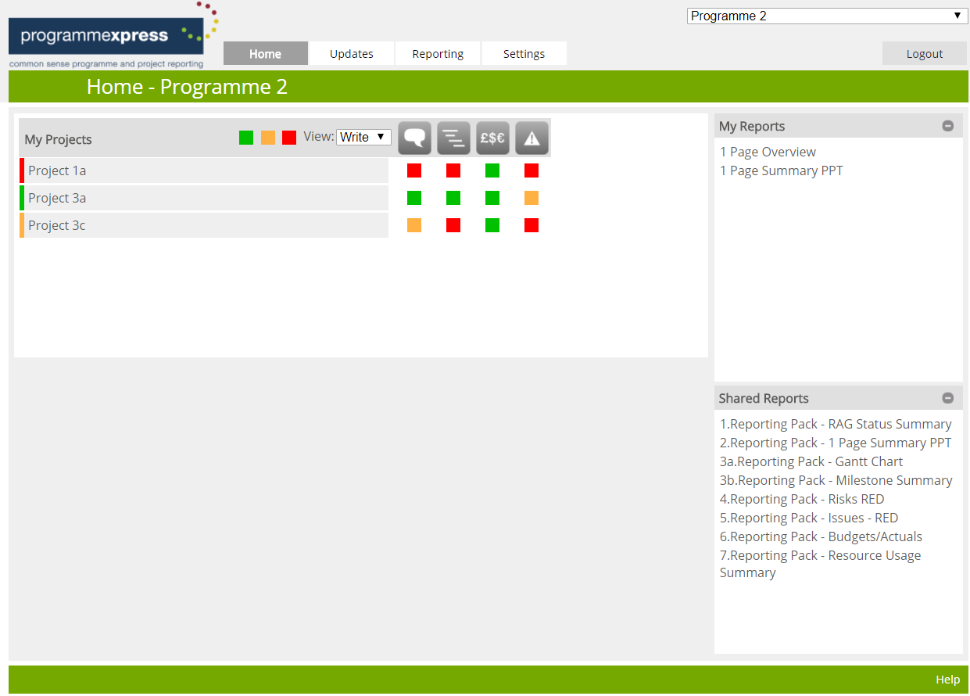
Home Screen – User Update View

Slide 22
What is our Key Message?
Aspiring to Enterprise PPM solutions may never materialise due to time and cost, and may leave you with manual solutions
Quality Project Governance is fundamentally important but:-
Be flexible
Don’t over engineer
Get the balance right
Let Project Managers do what they do for managing their projects in terms of tools and systems
You need a solution at Portfolio and Programme level, and the simpler the solution, the more engagement across the organisation at all Project Maturity levels, the more multiple Business Change Programmes can adapt to, more chance of the ‘Big Picture’ being available
Tools and Systems are a small, but essential, part of the success of a Programme/Project!!

Slide 23
Q&A
Further Discussion – Stand 128

