Slide 1
What does a Change Manager Do?
Melanie Franklin
Co-Chair
Change Management Institute UK

Slide 2
Objectives
Explain why everyone is talking about Change Managers
Understand the context and perspective of different types of Change Managers
Review the skills needed
Plan your career development activities
Notes:
POLL QUESTIONS
How many of you are involved in a change at work?
How many of you have a formal job title that includes the words change or transformation?
How many of you have a change management qualification?

Slide 3
www.change-management-institute.com
CREDIBILITY
Affording you membership and affiliation to a professional industry organisation
CAPABILITY
Ensuring you have access to opportunities to continually develop and be recognised
CONNECTION
Local connections within a global community
Notes:
I wanted to clarify my role and my interest in giving this presentation today – as the chair of the Change Management Institute UK I am here to raise awareness of the CMI and why we exist. Worth bearing in mind that the existence of professional bodies tends to be a lagging indicator, so our existence is a result of many people feeling that change management is a professional discipline.

Slide 4
Chief Persuasion Officer
Business Transformation Manager
Business Analyst
Team Leader
Employee Engagement Manager
Project Manager
Line Manager
Communications Manager
Director of People
Programme Manager
Relationship Manager
Head of PMO
HR Manager
Customer Experience Lead
Delivery Manager

Slide 5
Change Manager – fast growing opportunities
Organisations know the cost of failure:
Direct cost
Opportunity cost
Reputational cost
Change must be managed, not left to chance – IBM says 19% better chance if a CM is appointed
Huge number of transformational change programmes – digital; organisational; innovations
All industries affected – Prosci Research indicates 70% of banking, consumer goods, transport, utilities have CMs
CM role continues to grow – US firms with CMs: 43% to 53% in 2 years
Notes:
‘All’ organisations are changing, so not changing means being left behind

Slide 6
Where are Change Managers?

Slide 7
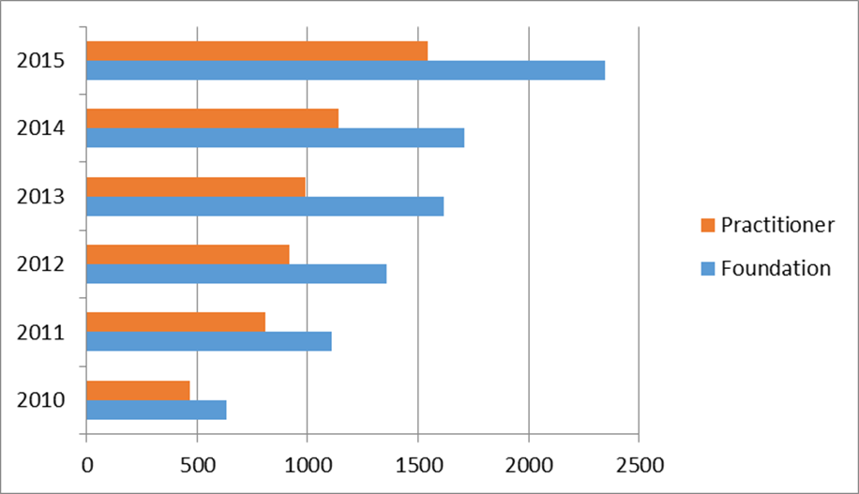
Jobs
Exams

Slide 8
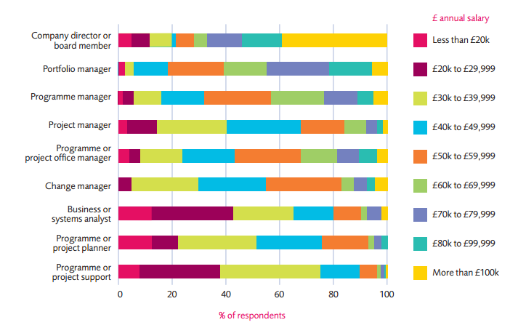
Salary

Slide 9
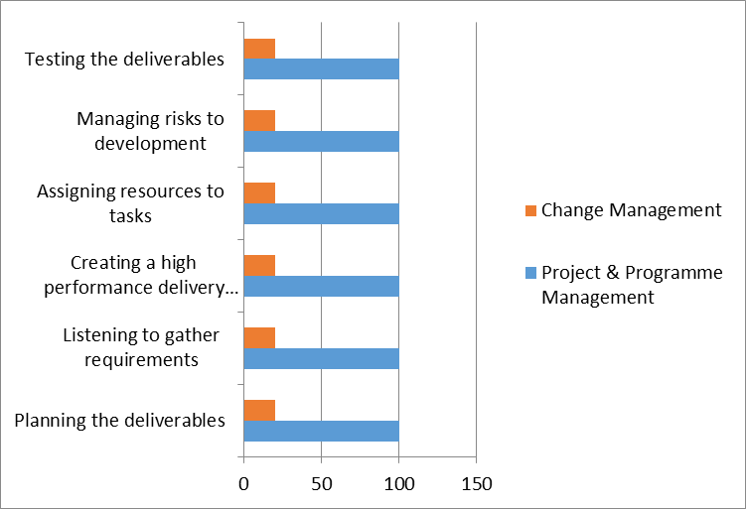

Slide 10
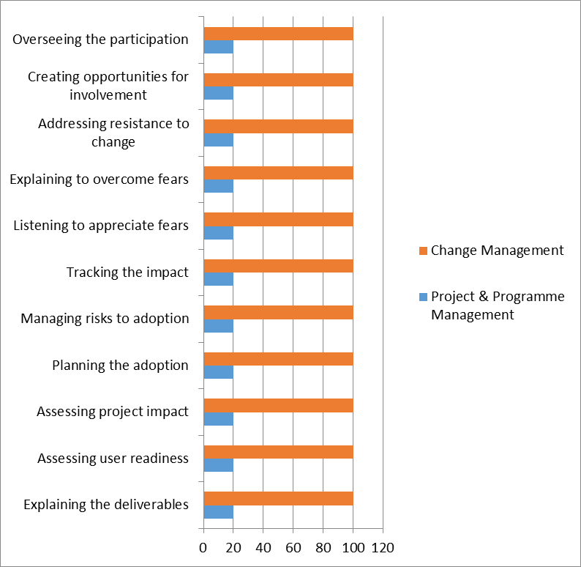

Slide 11
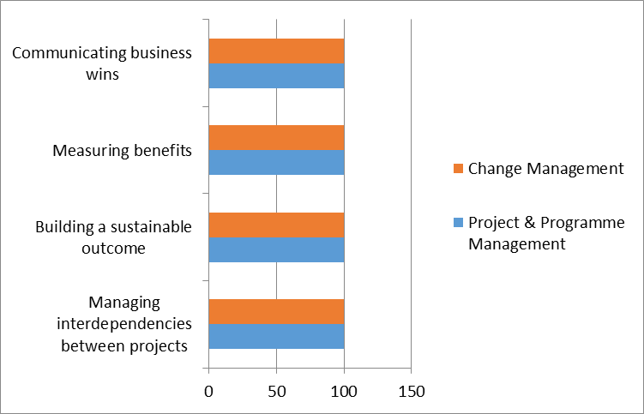

Slide 12
Specialist in what is being changed
Someone who leads the implementation
Maintains day to day responsibility for an area of the business so is closely impacted by what is being changed
Will be responsible for one or more:
Process re-design
Organisational restructuring
Business development – new products and services
Strategic planning

Slide 13
Specialist in creating a change capability
Responsible for ensuring change management is developed as a profession/skill internally
Enjoys developing and implementing best practice
Remit is across all specialisms and business functions of the organisation
Will lead development and adoption of a change framework
Change management lifecycle
Toolkit – guidance/templates etc
Governance framework
Approach to progress reporting
Training and development

Slide 14
Your development actions!
Get a deep understanding of what change management involves – you cannot get involved if you don’t know what is needed and what the core requirements are
Use your knowledge to decide where you want to direct your efforts – leading specific initiatives or leading the process of change
Build your portfolio of change experience – review your past roles to see where you have already led change
Create your network of change professionals – join the Change Management Institute!
Get qualified and accredited – change management is a professional discipline so demonstrate your professionalism.

Slide 15
Further resources
melanie@agilechangemanagement.co.uk
07960 995262
www.agilechangemanagement.co.uk
Linkedin: Melanie Franklin
YouTube: AgileCM
Twitter: @AgileMelanie

